Slide 1



Análisis SML Toxicología MG Dennise
View in Power BI
Last data refresh:
21/06/2023 23:30:02 UTC
Downloaded at:
22/06/2023 0:54:08 UTC

Slide 2
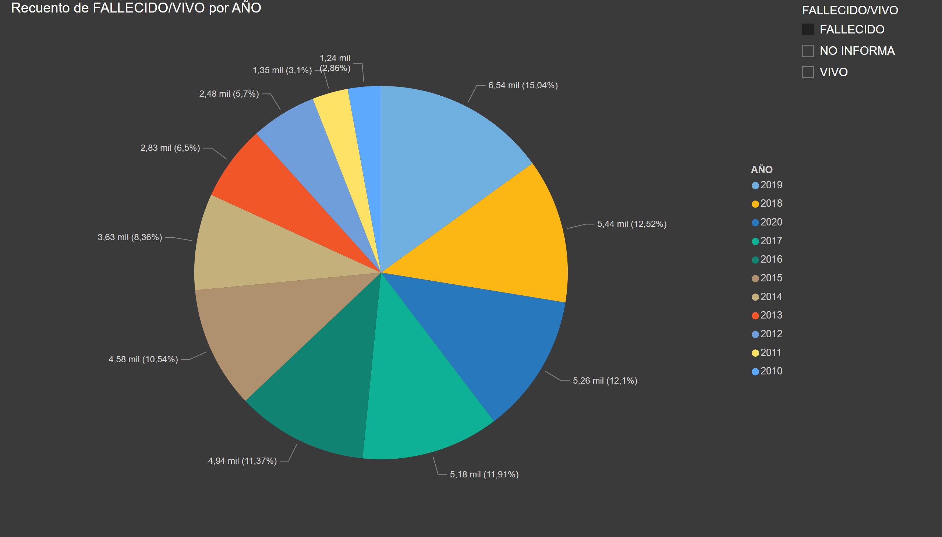
Torta Año Fallecidos
Notes:
pieChart
No alt text provided
slicer
No alt text provided

